Slide 1
Too Many Choices
Board Game Recommendation Systems
Notes:
Today we are looking at how we can use recommendation systems to sell more board games.

Slide 2
Problem Statement
There are nearly 120,000 board games listed on boardgamegeek.com.
The average price of board games continues to increase as component quality increases.
Notes:
It is overwhelming to be a consumer in the world today. We have thousands of possibilities for every item we might want to buy all directly at our fingertips. This is true in the board game industry as well. Boardgamegeek has nearly 120,000 different board games in their database, with more being developed every month. And on top of this, board game prices continue to climb as component quality is increased. The number of games keeps getting larger, and so does the financial impact of each sale. How can we help our customers find games they are interested in buying and avoid the risk of buying a game they don’t like? This is where recommendation engines comes in.

Slide 3
Business Value
Suggestive upselling
Improve website usability
Rotate stock quickly
Notes:
While recommendation systems are useful to customers, they will also help us to increase our profits. Specifically, we are looking to increase our sales by suggestively upselling to our customers, to increase customer retention by improving the useability of our website, and rotate our back stock of games and expansions.

Slide 4
Methodology
Recommendation Systems
Collaborative-Filtering
Content-Based
Memory-Based
Model-Based
Notes:
There are two main types of recommendation systems. The first is called content-based, and it focuses on the descriptive features of products. In regards to board games, this would be like comparing the games based off of things like the number of players or the amount of time required to play. The other main type of recommendation system is called collaborative-filtering. These systems use ratings supplied by users to compare games. The idea behind this is that if you and I both like the same game, but I also like a different game, then you might like that game too. We can further break down collaborative filtering into two more types. One is called memory-based and it uses calculated similarities in ratings between users to determine predicted ratings, and the other is called model-based which uses a more complex machine learning algorithm to identify underlying patterns and estimate ratings. For this project we have prepared a model of each of these types to compare the pros and cons. Now let’s talk more about our approach.

Slide 5
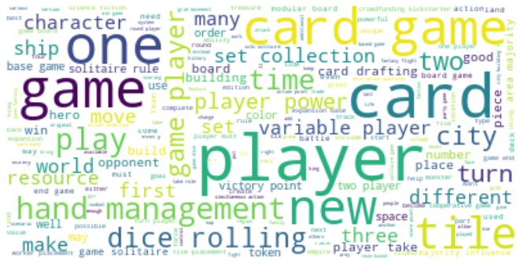
Methodology - Content-Based System
Notes:
First up, our content-based system. For our dataset we collected descriptive statistics on 2000 of boardgamegeek’s most popular games. We combined these statistics with a short description of each game into a block of text, and then we analyzed these blocks of text to establish patterns between the different games. Before looking at an example of our results, let’s look at the most repeated words in our text blocks. As you can see here, there are several words that you would expect to see when talking about board games. We see words like player, game and turn; and we also see some two word phrases like dice rolling, hand management and card game. We used a method to diminish the impact of some of the more common words (ie. player, game) which appear in most if not all text blocks to focus on what makes a game different.

Slide 6
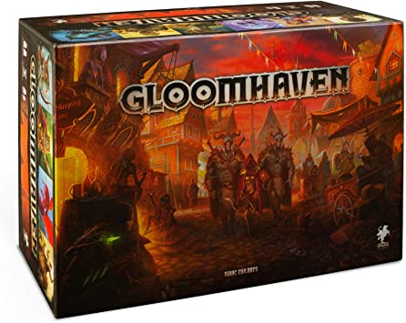
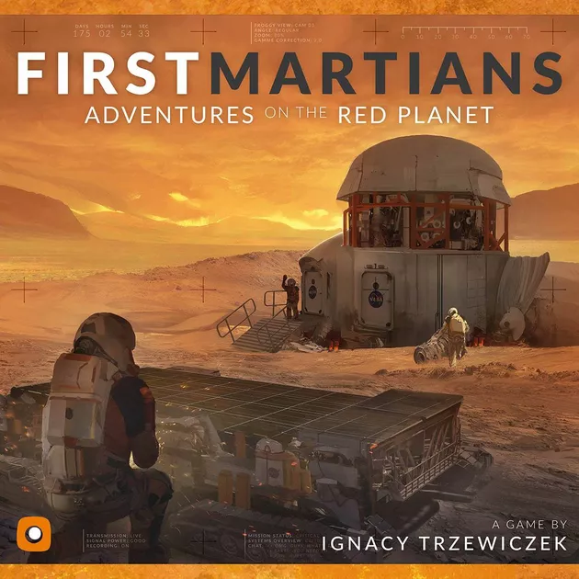
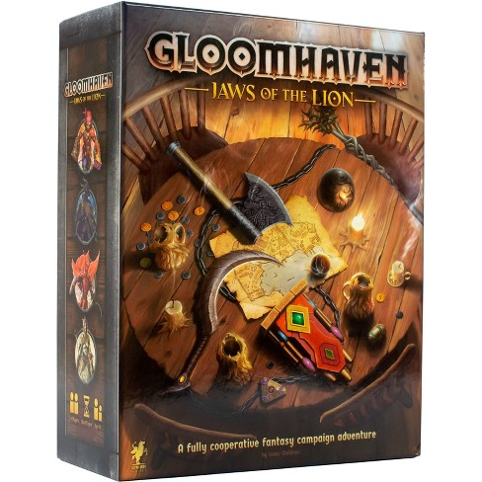
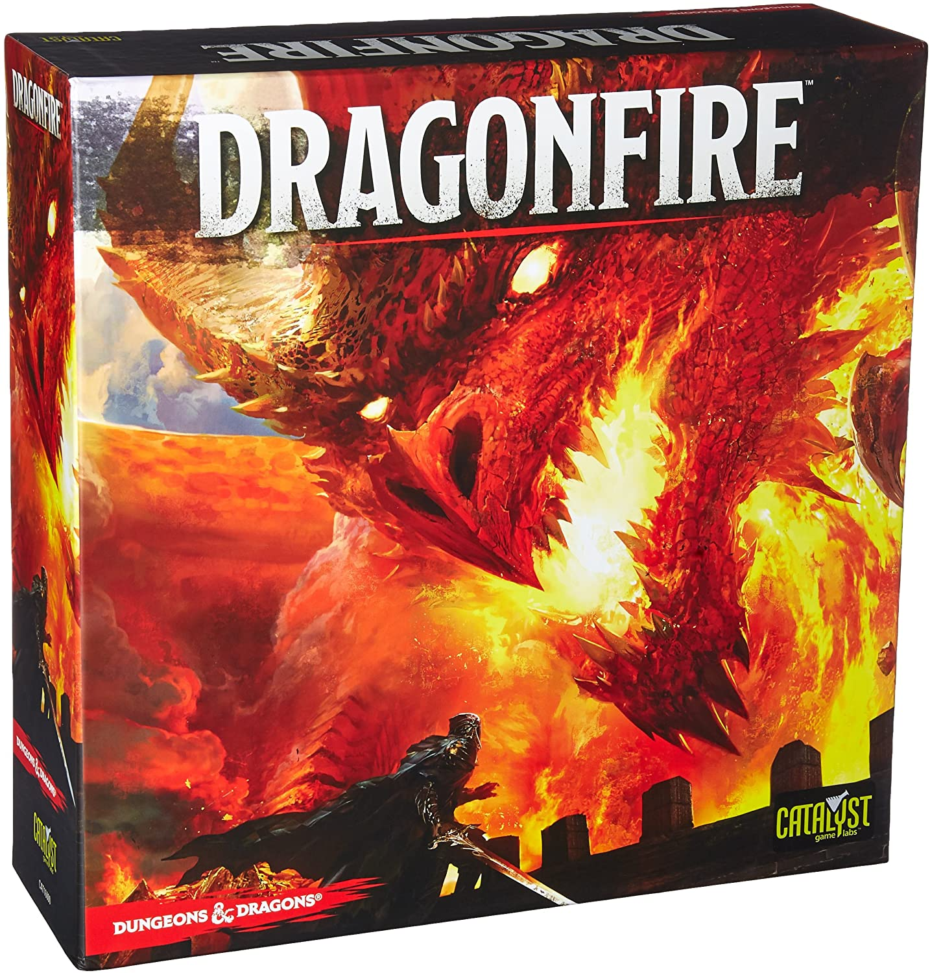
Content-Based Recommendations
Notes:
Let’s look at an example of our content-based recommendation system in effect. Let’s see what games are most similar textually to boardgamegeek’s top rated game Gloomhaven. Our system recommended Gloomhaven: Jaws of the Lion, a stand alone expansion to Gloomhaven, Dragonfire which is a board game based off of dungeons and dragons which Gloomhaven also drew heavy inspiration from, and First Martians. It’s very easy to see why the first two recommendations were made, the games are very similar in terms of themes and mechanics. First Martians is a bit of a stretch though as it is space themed compared to the high fantasy theme of Gloomhaven. However, both games do have a campaign element as they are played across multiple scenarios and they both have some similar mechanics. Overall we can see that these games have similar features, but an important question is will a customer who enjoys playing Gloomhaven also enjoy these games. For that we turn to collaborative-filtering.

Slide 7
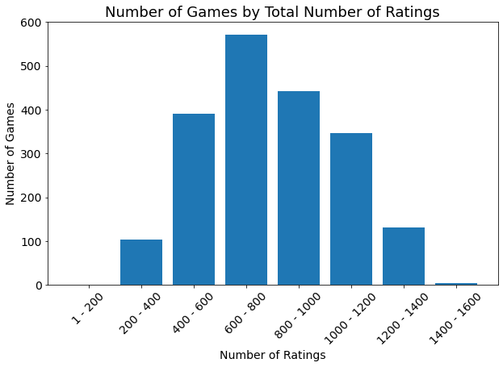
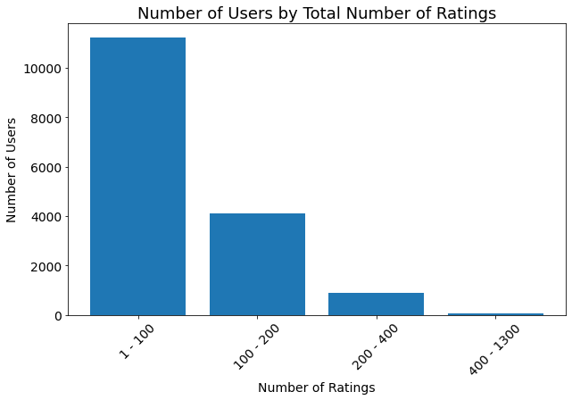
Methodology - Collaborative-Filtering
Notes:
For collaborative-filtering systems we use user ratings instead of descriptive features. For this project we obtained close to 3.7 million reviews for the most popular 2000 games. Here is a quick look at the distributions of our data points. You can see that most of our games had between 600 and 1000 ratings and most of our reviewers had made less than 100 ratings. Our data is a little sparse in that we ideally would like to have users rate more games, but it is hard to play that many board games as they take up quite a large amount of space and are a sizeable investment. Using this data we calculated the similarities for each user and item interaction and used these similarities to calculate recommendations. This is our memory-based system.

Slide 8
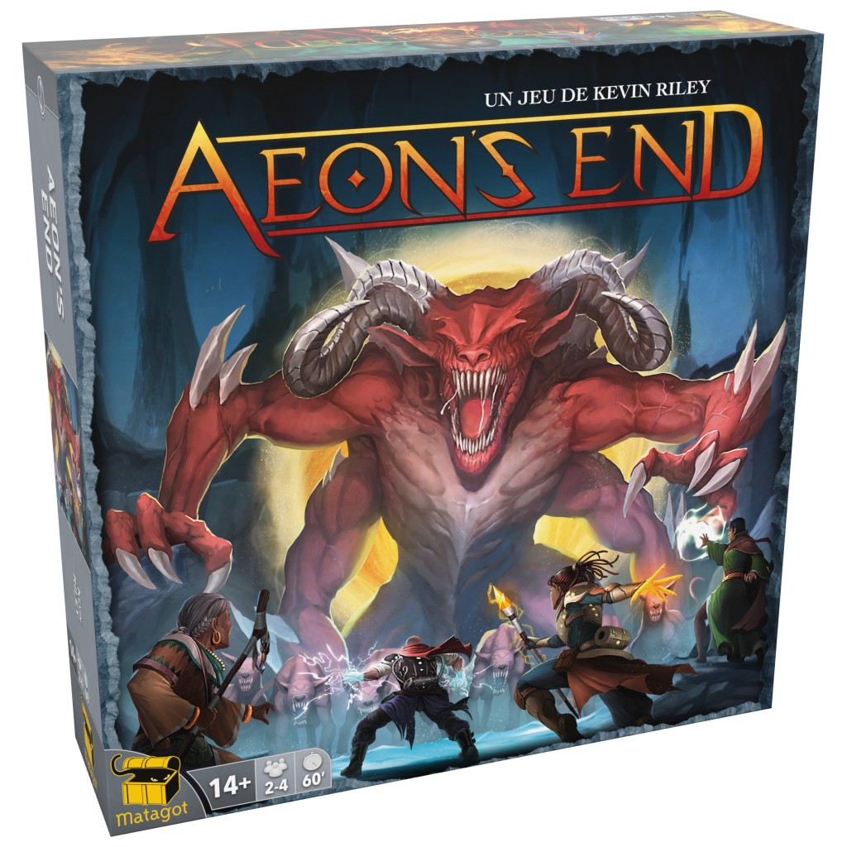
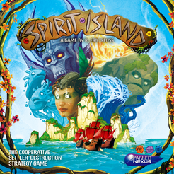
Memory-Based Recommendations
Notes:
Let’s once again take a look at the highest ranked game Gloomhaven. Now, let’s see what our memory-based system recommends. Again, we see that Gloomhaven: Jaws of the Lion is a recommendation, but we also see Spirit Island and Aeon’s End this time around. Before we saw games that had similar themes and mechanics to gloomhaven, but this time we see games that have similar popularity. These are the games that had the most similar ratings to Gloomhaven.

Slide 9

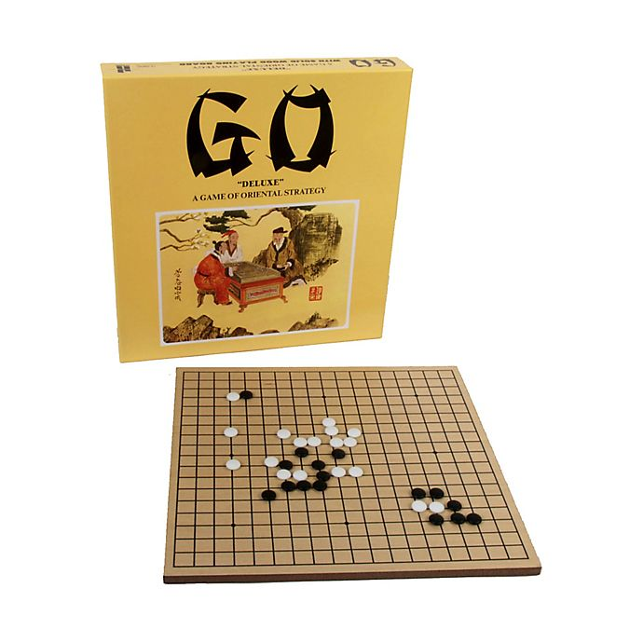
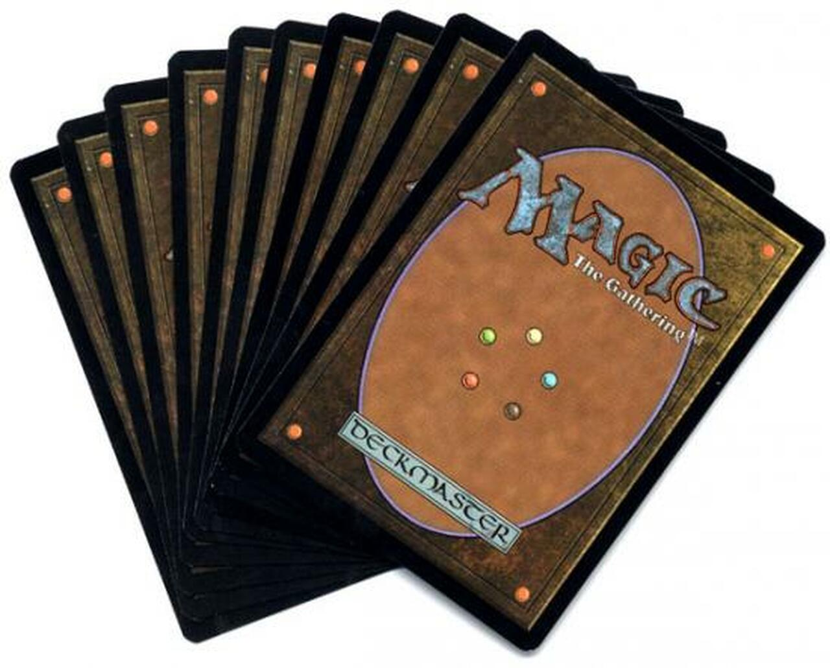
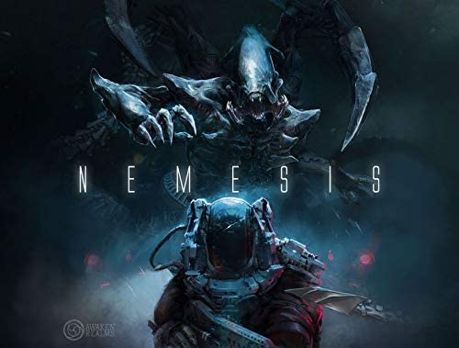
Collaborative-Filtering Recommendations
Notes:
Now let’s talk about our model approach to recommendation. I’m not going to get into the specifics here, as it can get a bit technical, but we used a high functioning machine learning algorithm to make recommendations. The key factor to this approach is that it will compare users, not games. So in this case, I entered some of my favorite games. Let’s see what our model recommends for me. We see Magic the Gathering, Nemesis, and Go. One of these (Magic) is another of my favorite games, and the other two are games that I have been considering playing lately, but have been unable to find someone to play with. Overall we have some very good recommendations tailored to my personal taste, and using this system we could tailor recommendations to any user who provides ratings.

Slide 10
Recommendations
Use content-based system for suggesting similar items.
Encourage customers to rate games that they buy
Use Collaborative-filtering for users with reviews
Notes:
So, now that we have these systems, what can we do with them? First off, I recommend that we implement the content-based system to recommend similar items to our customers while shopping. We can incorporate these recommendations into a banner on their screens with a title like “Products Similar to X.” This will enable our customers to see games that share themes or mechanics and will drive our sales up. Second, we can implement our memory based system in a similar way. We can choose to do this in addition to, or instead of the content-based system. This banner would have a title like “Customers who liked this item also like …” Using these two banners in tandem allows our customers to see games that they might be interested in thematically, and games that they are likely to enjoy playing. Implementing the model-based system might be a little trickier at first as it requires explicit ratings to make recommendations. To account for this, we can create a part of our webpage where customers can go specifically to get game recommendations. There they can enter their favorite games and rankings and we can offer them personalized recommendations with links to the product page in our store. Ultimately, no matter which of these systems we implement, they should lead to increased sales for the store and better navigation for customers.

Slide 11

Next Steps
Gather more reviews
Build a system to account for implicit ratings
Refine our language processing techniques
Notes:
Now let’s talk briefly about how we can refine these recommendation systems. To improve the results of our model-based system we need to increase our ratings. If we can find users who have rated more games, this will help us to fill in our data set, and as the data set improves, the recommendations will get better. Part of this problem will solve itself as it is used, but we will need to retest the parameters as we get more data to get the best results. We could also develop a model designed for implicit ratings. This will allow us to offer personalized recommendations to customers based on which games they have looked at on our site. This will allow us to implement a model-based approach without needing customers to tell us their exact ratings. And finally we can look at refining the list of words we are using for our content-based system. By carefully choosing which words we are using in our analysis we can create better recomendations.

Slide 12
Thank You!
Any Questions?
Notes:
Thank you for your time today! Are there any questions?

Slide 13
Appendix - NLP
Used the name of game, designer’s name, artist’s name, publisher’s name, and short description for each board game along with a list of which categories, mechanics and families the boardgame showcased as our text.
Used two approaches:
Count frequency - Rated similarities based on the count of each words.
Tf-idf vectorizer - Normalized the count of each word by reducing the impact of words that appear in many descriptions (ie. player, game).
Attempted to tune our approach by removing the name of the game, the designer’s name, the artist’s name and the publisher’s name; but, there was no effect on the recommendations.
Notes:
Details about our content-based system.

Slide 14
Appendix - Memory-Based Collaborative Filtering
Built a K-nearest neighbors model to compute cosine similarity.
Top 5 recommendations for users who like ‘Gloomhaven’:
1: Gloomhaven: Jaws of the Lion, with distance of 0.8302014392979479:
2: Spirit Island, with distance of 0.8408221723065283:
3: Aeon's End: Legacy, with distance of 0.8472333914652613:
4: Founders of Gloomhaven, with distance of 0.8482777123514965:
5: The City of Kings, with distance of 0.8491417494404531:
Notes:
Details about our memory-based system.

Slide 15
Appendix - Model-Based Collaborative Filtering
Baseline RMSE: 1.0; RMSE after tuning 98.5
Imputed user ratings:
'Cthulhu Wars': 8
'Terraforming Mars': 9
'Gloomhaven': 9
'Twilight Imperium: Fourth Edition': 8
'Mage Knight Board Game': 8
Predicted recommendations: Recommendation 1: Nemesis | Predicted Score = 8.8 Recommendation 2: Go | Predicted Score = 8.6 Recommendation 3: Magic: The Gathering | Predicted Score = 8.6 Recommendation 4: Twilight Struggle | Predicted Score = 8.57 Recommendation 5: Puerto Rico | Predicted Score = 8.57
Notes:
Details about our model-based system.

